Slide 1
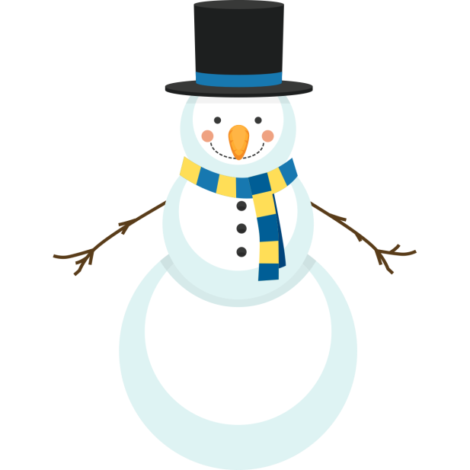
If only
If only my snowman never melted so he could help me with my school work
If only I could pick up a blade of grass and turn it into sunlight
Scout

