Slide 1
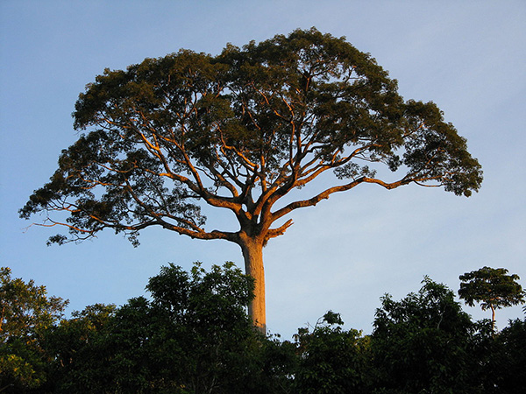
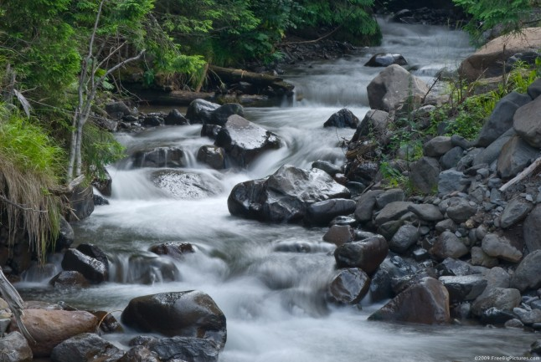
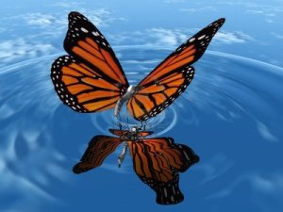
If only...
If only I could pick up a giant tree and use it as a house.
If only I could pick up water from a stream, I would make it into a butterfly.
Ellie

