Slide 1
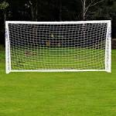
If only
If only I could be in a real football match, I might score the winning goal
If only I could climb a really high mountain I could see the clouds of heaven
Joseph

