Slide 1
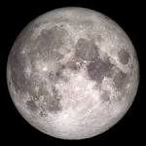
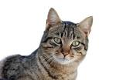
If only...
If only a horse could speak, would it say “moo”?
If only a cat could speak, would it ask for its dinner politely
Emily

